Slide 1
Inspection and Qualities of User Experience
Martin Colbert

Slide 2
Contents
Inspection
Qualities of usability (12)
compatibility - transparency
coherence - completeness
simplicity - controllability
redundancy - flexibility
salience - feedback
reversibility - support orientation
Qualities of User Experience (4 + others)
engaging - credibility
fun - persuasiveness
Relevance to coursework
What “kinds of usability issue(problem)” are likely to arise?

Slide 3
Usability Inspection: Techniques
4 main techniques
Cognitive Walkthrough
Style Compliance
Heuristic Evaluation
Consistency Checking
Essentially a similar process
designer walks through a task scenario from user’s point of view;
at each step, designer asks him/herself pressing/detailed questions
Different techniques pose different questions

Slide 4
Usability Inspection: Questions
Questions for Heuristic Evaluation
Does the interaction exhibit the quality of use in my list of desirable qualities
Hopefully, you remember heuristic evaluation from earlier in your education
If not, no worries, it is easy ;-)
https://www.nngroup.com/articles/how-to-conduct-a-heuristic-evaluation/

Slide 5
Usability Inspection: Questions
Questions for Heuristic Evaluation
Does this interaction have good <quality of use>?
‘Easy to use’/’usable’ is one quality of use. But we need others ...
These qualities must:
apply to a wide range of interactions
cover a wide range of problems
These qualities must not:
Mix up qualities of use, with features of a user interface, or sequences of behaviour
e.g. “Does this page have a search box?”
e.g. “Can I try something out, get feedback, try something else out safely, until it works?
I don’t recommend Nielsen’s original heuristics, but the article is legend

Slide 6
Usability Inspection: Questions
Questions for Cognitive Walkthrough
Will users be trying to achieve the next step (effects of action/goal)?
Will users notice that the required action is available?
If found, will users map their goal onto this action?
If the action is taken, will users understand the feedback they get?
(together, these essentially ask can the system be learnt through exploration?)
Questions for Compliance Assessment
Does the selection and detailed design of this UI component follow the mandatory/suggested guidelines in the styleguide? (see later)
Questions for Consistency Checking
Is this design consistent with other analysis and documentation, (Hierarchical Task Analysis, User Requirements Specification, raw data)?
(in effect, can you conduct explicit, top-down design?)

Slide 7
Usability Inspection
Advantages
analytic (‘thought’-based) evaluation techniques
Need not have a fully functional system - a paper-prototype or interactive mock-up will do
quick and cheap
can be applied early in the development cycle i.e. during a design iteration
but, it also follows that:
the assessment is just opinion, albeit well-informed and rational.

Slide 8
Component Qualities of Usability
12 qualities of usability
compatibility - transparency
coherence - completeness
simplicity - controllability
redundancy - flexibility
salience - feedback
reversibility - support orientation
Denley, et al. 1992
This lecture will illustrate each of these qualities, with respect to two systems – PC desktop, interactive TV for education and training.

Slide 9
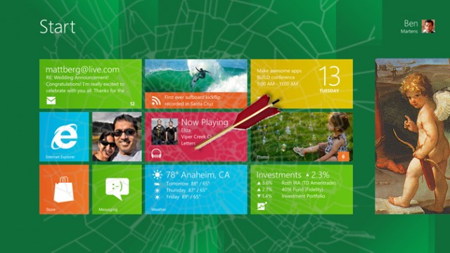
Example A:
PC Desktop (Win3.1, Win95, Win2000, WinXP, Win8)
Notes:
users - initial knowledge
user group - local moderation, expectations
computers-what equipment is at different sites
network- Internet what network performance was actually delivered
work - what does learning process comprise - different theories rote repetition and internalisation, reflection upon theory and action
quality of task outcomes - measure by multi-choice, exam or practical exercise, attendance
‘costs’ to the user - learning is difficult?
‘costs’ to the computer - what equipment was used
motivation to achieve good grades
rapport with lecturer
administrative context
solution from example - give questionnaire and interview ‘live’ at the end

Slide 10
Examples: Interactive TV for training
Production quality Mercedes ‘Car Repair TV’ meets eurovision voting
High-tech lecture theatres for training doctors at multi-sites (hospitals)

Slide 11
Quality of Compatibility
“Users should be able to apply knowledge they have gained from outside the system. This will help them to learn to use the system, and reduce the amount of new information to be interpreted and remembered”

Slide 12
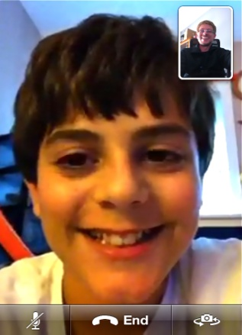
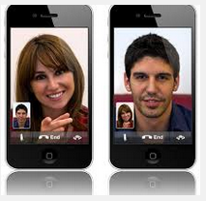
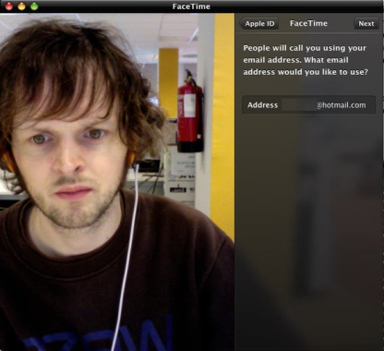
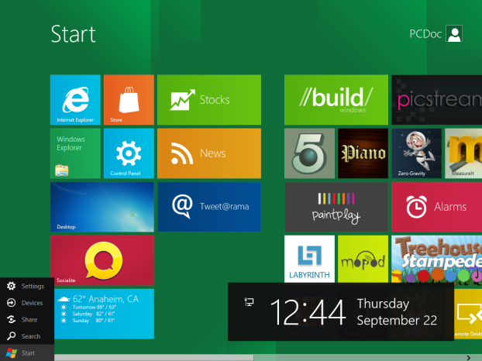
Compatibility: Example
iTV:
turn-taking is controlled in face-to-face dialogue using gaze, but on interactive TV– you must look at camera to look someone in the eye i.e. Not compatible
Win8:
There is no XP-like Start menu!
Real: gaze down
posed: direct gaze
Notes:
iTV new cues - face appears on screen, director explicitly ‘gives you the floor’
Win 95 sometimes it is <Alt-C> for close

Slide 13
Quality of Coherence
“Users should be able to generalise their experience between system components. This helps them to learn to use unfamiliar components and reduces the amount of new information to be interpreted and remembered”

Slide 14
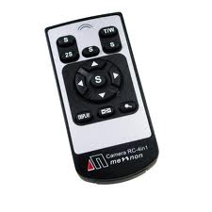
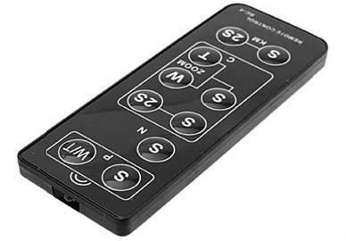
Coherence: Example
iTV:
Interaction is often incoherent, because the controls for same action eg pan, zoom, are often different. The equipment in lecture thatres is often obtained from over many years, from different suppliers and so have different UIs
Win95:
‘My Computer’ is a special window, from which objects may not be removed and to which files and folders may not be added. In this regard, the UI is not coherent (but harmlessly) – I would not expect to uninstall my hard drive by dragging it to the trash can

Slide 15
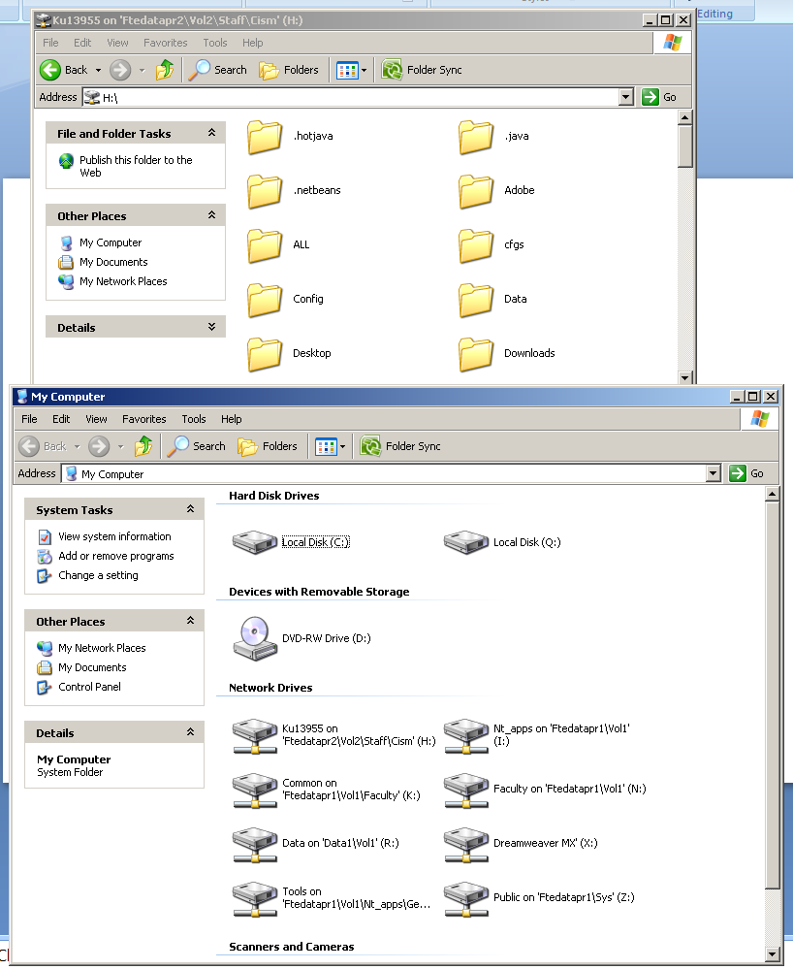
draggable to trash
Not draggable to trash

Slide 16
Quality of Simplicity
“The number and complexity of necessary user actions should be minimised, thereby also minimising mental and physical effort (eg memory load and keystrokes)”

Slide 17
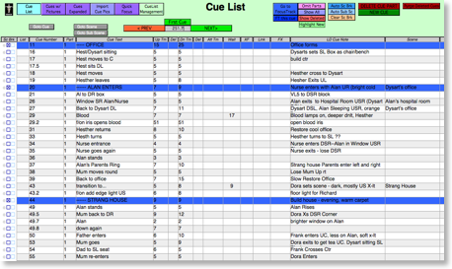

Simplicity: Example
iTV:
Lectures may involve material from various sources - software, transparencies, video clips, internet sites. Rather than set up different devices during the lecture, presenters often create a ‘cue list’. To show the next item on the list, just press the next button/right arrow key i.e. Keep it simple
WinXP:
Menu strip attempts to make interaction simpler for novice users. The commands most frequently used by most novices are available on the strip as toolbar buttons. More advanced options are hidden in sub-dialogs

Slide 18
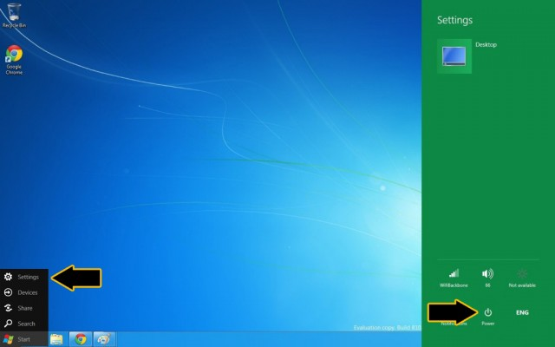
To reboot, click Start button in system tray (bottom left), select Settings ‘charm’ (menu option), move to right hand side and click ‘Power’ button

Slide 19
Quality of Redundancy
“The user should be provided with summary information in several ways. This reduces the load on memory.”

Slide 20

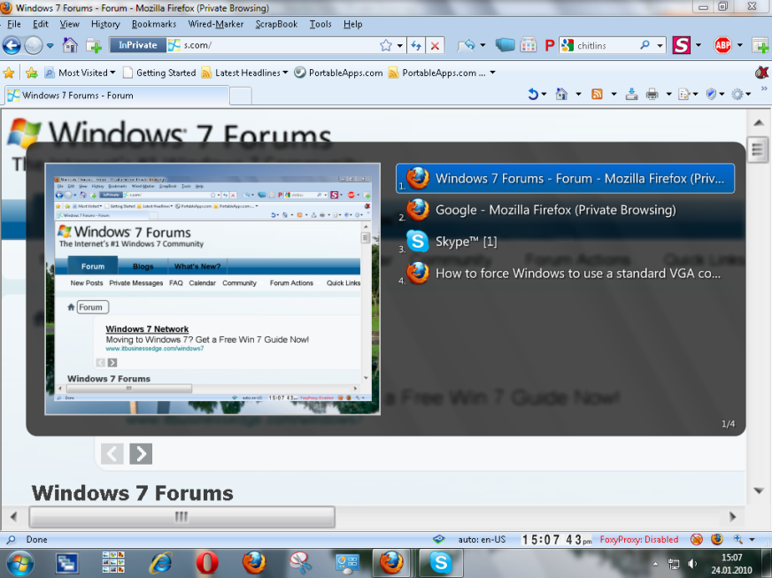
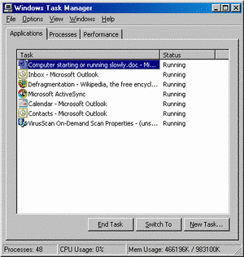
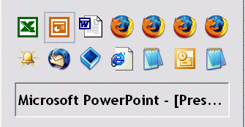
Redundancy: Example
iTV:
the presenter knows which local studio he or she is talking to text superimposed on the video feed, the set in the local studio has a logo in the background, and dialogues open with “Hello, Newcastle here” ie redundant interaction
WinXP:
The state of my personal workspace is conveyed on the task bar, by the array of application windows visible on screen and by the list of open applications viewable by keying Alt+Tab, and Task manager. It is redundant
Barry University

Slide 21
Quality of Salience
Critical information should be presented in a sufficiently intrusive way. This draws attention to the most critical part of the system at a given moment, and helps users not to miss important information.

Slide 22
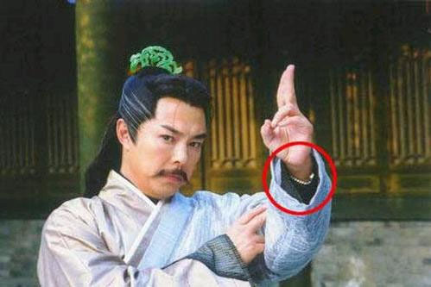
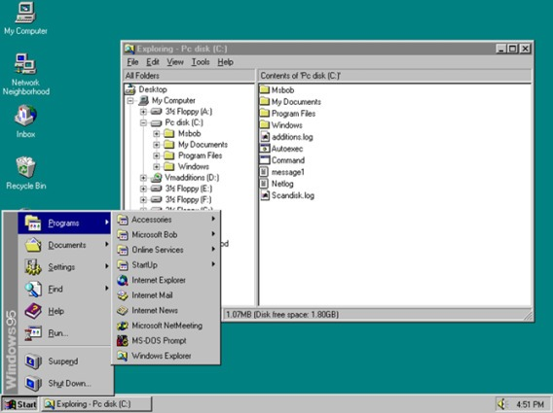
Salience: Example
iTV:
can a presenter spot someone in a remote site raise their hand? A dot on one of several monitors is not very salient
Win95:
The ‘Start’ button is not always very salient to novice users, so early versions had a text instruction that moved from right to left across the task bar, ending up adjacent to the Start button. The Text read ‘←To begin using your computer, press the ‘Start’ button.’

Slide 23
Quality of Reversibility
The user should be able to restore pre-existing states of the machine. This allows users to change their mind without having to re-set or re-configure the system themselves.

Slide 24

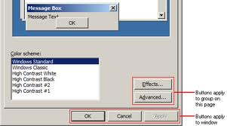
Reversibility: Example
iTV:
A lecture is not reversible. Presenters cannot pretend they have not made mistakes. Students could review a lecture on videotape, perhaps.
Win95:
some users do not understand that the ‘Apply’ button in a multitab property dialog box saves the property settings, but does not close the window i.e. The ‘Cancel’ button will cease to reverse the interaction – Cancel reverts to the state stored when the ‘Apply’ button was clicked, not when the dialog box was opened. The ‘Undo’ command must now be used to ‘reverse’ to a previous state.
Notes:
iTV: ask, or get a videotape
Win 95: apply’ is not ‘
preview’ i.e. changes may not be canceled once they have been ‘Applied’

Slide 25
Phew – we’ve done 6/12

Slide 26
Quality of Transparency
Information about tasks which can be performed, as well as about the states of the machine, should be stated unambiguously and clearly. This should help the user to predict the consequences of their planned actions. No trial and error behaviour is necessary.

Slide 27
Transparency: Example
iTV: transparency of audio channels
how do students know when ‘they have the floor’ (push to talk microphones vs voice activation and recency selection vs manual control and cuing by director. Many wait to see themselves on the broadcast monitor.
how could students know who else is receiving their communication to a central site?
Win95: transparency of modes
“What’s This” interrogation tool has a different icon (click displays pop-up tip, not execute command)

Slide 28
Quality of Completeness
Information about tasks which can be performed, as well as about states of the machine, should be complete in such a way that all options are presented simultaneously. This reduces the memory load of the user, so giving them the opportunity to select between all potential options and task actions.

Slide 29
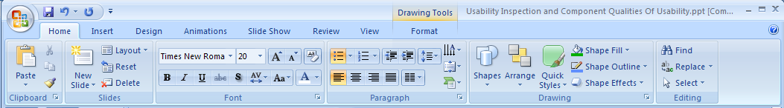
Completeness: Example
iTV:
some local sites have audio-only connections. These sites are not displayed to presenters as are others through a TV monitor. Because the video display is not complete, audio-only sites lack presence, and tend to get ignored
Win95:
The main menu structure is a complete representation of application functionality

Slide 30
Quality of Controllability
“The user should be able to control the actions of the machine. Consequently, users should be able to perform their actions as intended.”

Slide 31
Controllability: Example
iTV:
Lecturers do not have control over cameras in remote lecture theatres. Students sometimes use them as ‘electronic paper darts’ and have a laugh (but distract everyone else) by zooming in on their friends nose etc.
Win95:
Some installation wizards do not let users control how they will open the new application – under the start menu, short-cut on the desk-top, neither of the above
Mr Clippy is out of control (☺). He thinks he knows when I want Help and tries to adapt the interaction to me, but he doesn’t guess right and just annoys me
Notes:
remote sites need control over local cameras to maintain their privacy, or adapt the studio to the work required eg move the camera to point at a flip chart. But remote sites may disrupt proceedings by inappropriate use of cameras e.g zooming in on themselves and pulling funny faces

Slide 32
Quality of Flexibility
The user should be able to choose the modalities of their task performance with respect to the input media available and the experience they have. This lets users perform the tasks in the most appropriate and efficient way, and encourages the development of specific user strategies.”

Slide 33
Flexibility: Example
iTV:
With a video camera, remote users can show you something they have done, and tell you what they have done. The camera is a flexible communication tool.
Win95:
Commands can be executed using the mouse and main menu, pop-up menu, the tool bar, or buttons in a dialog box, or via the keyboard short-cuts. This is flexible interaction, because the user can choose which method they prefer at any point in time.

Slide 34
Quality of Feedback
“The user should be informed about the consequences of their actions. This lets the user understand the actions and states of the machine and allows them to avoid errors and plan their next actions.”

Slide 35
Feedback: Example
iTV: feedback from remote sites
The reaction of a remote audience is sometimes difficult to judge via video and audio links. Presenters miss the feedback they get from a live audience
Win95:
progress indicators sometimes give inaccurate feedback about the progress of download during web browsing. They sometimes indicate progress of downloading a particular component on a web page, such as a large image, not the page as a whole (what the user is interested in)

Slide 36
Quality of Support for Orientation
“If the information to be presented is too complex or covers more than is possible to present at one time, the user should be helped to find the relevant information by giving them support in orientation. This lets the user find relevant information easily and helps them to perform even complex tasks.”

Slide 37
Support for Orientation: Example
iTV:
if a door slams in one of the studios, a presenter sometimes does not know in which studio the door has slammed – he or she just hears the noise. The absence of an overview of activity in each studios is disorienting.
Win95:
A summary of the content of my workspace is displayed in the Task Bar

Slide 38
Summary: Component Qualities for Usability
the 12
compatibility - transparency
coherence - completeness
simplicity - controllability
redundancy - flexibility
salience - feedback
reversibility - support orientation

Slide 39
Qualities of User Experience: Total End-to-End Experience
End to end, ‘total’ encounter. ‘Out of the box’ experience.
E.g. Router: unpack, connect cables, install software, register, activate, use, upgrade, maintain, uninstall, dispose
Not an isolated task or interaction, but one encounter or ‘touch-point’ on a ‘user journey

Slide 40
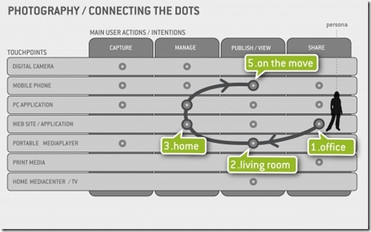
Qualities of User Experience: Total End-to-End Experience
“disjointed”,, “incomplete”, “not joined-up”

Slide 41
Learnability
}
at least 3 senses
Immediately obvious:
“intuitive”, “guessable”
Rapid rate of learning
Productivity Gain/benefits of
learning
productivity
{
task1 task2 task3 ...
time

Slide 42
Learnability
learnability profile for a kiosk
learnability profile for office software
Less guessability for more rate of learning and productivity gain
productivity
More guessibility for less rate of learning and productivity gain
task1 task2 task3 ...
time

Slide 43
Memorisable:
recall for passwords
Occasional tasks – annual tax returns
What learning strategies are effective:
Explorable – learn by trial and error

Slide 44
User Experience: Perceptions
“Virgin believes in making a difference. We stand for value for money, quality, innovation, fun and a sense of competitive challenge.
...” business must be a force for good and use its influence and resources to help find solutions to some of the world's major issues “

Slide 45
User Experience: Perceptions
“transparency” – government, complaints
“credibility”
Trustworthiness
Expertise

Slide 46
Persuasiveness
to perform a target action and/or to adopt a target belief
Engagement
Duration and intensity of discretionary use

Slide 47
Summary: Qualities of Usability and User Experience
12 qualities of usability
Compatibility (coherent with world) - transparency (current state is clear)
Coherence (coherent with self) - completeness (all available actions displayed)
Simplicity (min actions/decisions) - controllability
Redundancy (duplicate key info/actions - flexibility (user selects I/O mode)
Salience (key highlighted) - feedback
Reversibility (universal undo) - support orientation (context is clear)
additional qualities of user experience
Learnability (guessability, rate of learning, ultimate productivity, memorable, explorable)
Perceived ... Brand values, transparency of decision making, credibility
Persuasion
Engagement

Slide 48
Summary: Lessons
these qualities are frequently useful prompts for assessment – don’t worry if they need not always apply usefully. Some interpretations may not be useful.
Use these terms to identify the kind of usability and user experience issues that your users might raise.

Slide 49
References
Preece t al, 2002, Interaction Design Chapter 13 ‘section ‘Asking Experts’ pp407-422
Definitions of Qualities
Denley, I., Hedman, L. R., Hill, B., Whitefield, A & Papadopoulos, A, Clarke, A., and Hine, N. 1993, Usability Principles for Service Design. In Computers, Communication and Usability: Design Issues, Research and Methods, Byerley, P Barnard, P and May, J (eds) Amsterdam: Elsevier, 291-343.
Interactive TV
Colbert, M., Voglimacci, C. and Finkelstein, A. 1995, Live, Audio-Visual Communication Systems for distance learning: experience, heuristics and ISDN, Behaviour & Information Technology, 14(5), 267-288.
Windows 95
Sullivan, K 1996, The Windows 95 User Interface: A case study in usability engineering. Proceedings of ‘CHI96, Boston, ACM, 473-480.
Cognitive Walkthrough
Wharton, C., Rieman, J., Lewis, C. And Polson, P. The cognitive walkthrough: a practitioner’s guide. In Usability Inspection Methods. John Wiley, New York, 1994.
Towards user Experience
http://cost294.org/upload/408.pdf

Slide 50
Usability Inspection: Questions
EXTRA – to inspect for styleguide compliance, you need to know what a styleguide is
Questions for Compliance Assessment
Does the selection and detailed design of this UI component follow the mandatory/suggested guidelines in the styleguide?
Does this combination of components follow general design patterns in an appropriate way?

Slide 51
What is a Styleguide?
purpose
A resource that encourages consistency and coherence
carry forward knowledge about detailed design
constitutes
a specification of “look & feel”, physical user and computer behaviours
comprises
general principles for GUI design
advice about how to apply the styleguide
specific components, and associated guidance
features shared by many components
user population, I/O devices, computing environment

Slide 52
Styleguide: Contents
General Principles
Criteria (heuristics, qualities of interaction)
Design
Features Common Across Components
use of I/O devices (mouse, keyboard, pen)
elementary interactions (selecting, editing and creating)
Definitive Specification of Components
Windows (frames)
Menus, Controls, and Toolbars
Secondary Windows (dialog boxes)
Design Patterns (wizards, modes, metaphor)
Other Issues
internationalisation
visual appearance
special needs
user assistance (design of Help, messages)
integration with environment (object linking & embedding)

Slide 53
Styleguide: (i) Select; (ii) Customise
Select
common source - company, environment, project
other standards - ISO 9421
organise support and enforcement
Enhance
design rules, and findings from research lit.
Customise
omit, extend, add
change?

Slide 54
Styleguide: Example
A custom control: Icon_Listbox
may be helpful if meaning of labels alone is unclear
see icons section for advice about icons

Slide 55
On-line Styleguides
http://www.msdn.microsoft.com/library/
under UI Design and Development “The Windows User Experience”
http://info.med.yale.edu/caim/manual/
Web Style Guide

Slide 56
Design Patterns
Configurations of more basic elements components for common tasks
E.g. Forms, Search, Tables
www.ui_patterns.com
http://patterns.endeca.com/content/library/en/home.html

Slide 57
aka ‘Standard Layouts for Page Types’
Home page
Landing page
Navigation page
Article page

